Slide 1
10/15 Welcome Debate Team!
Login and go to http://patapscogt.weebly.com/debate to take the quick survey at the top of that page
Copy 1-2 of the debate issues you chose and brainstorm arguments for each side (pro and con) (on paper or GAFE).
Notes:
Attendance & remind to check in to class first
Talk to kids on issue list
Check summary of responses before revealing resolution!

Slide 2
Today’s Agenda:
Seminar Expectations/Procedures
Team Format
Resolution, Debate date
Stakeholders, Arguments, Resources
Notes:
*MUST clear date with teacher ASAP as you get calendar! Take out calendars & highlight (show mine); makeup work, etc.
HUGE group this year – 33 6th, 26 7th & 8th – 60! Can only take 18 as “travel” team… won both last year, def. ☺, but not what it’s about. Basically, you put in the effort, from this point on – and that will matter more than how well you write or even perform in mock debate.
Explain format: county resolution, 2 teams of 9, debate both sides

Slide 3
"Be it resolved that Unmanned Aerial Vehicles (drones) should be banned for private use in the State of Maryland."
County Debate: March 21, 2016
Notes:
Be it resolved that Unmanned Aerial Vehicles (drones) should be banned for private use in the State of Maryland.

Slide 4
Who are the Stakeholders?
a person or group that has an investment, share, or interest in something
Why are they important to consider in debate?
In groups, identify the key stakeholders for the resolution and their positions
Notes:
Also listed pro/con arguments for bag ban resolution on chart paper

Slide 5
HW: Bring in folder for Debate
Visit my website for resources & start researching for more!
http://patapscogt.weebly.com/debate

Slide 6
10/27 Welcome Debate!
Think about and be ready to share: What might be reliable sources be for our Debate research?
Login to GAFE
Library Media Center!
http://pms-lmc.weebly.com/
eTools – MasterFile Premier or SIRS KnowledgeSource

Slide 7
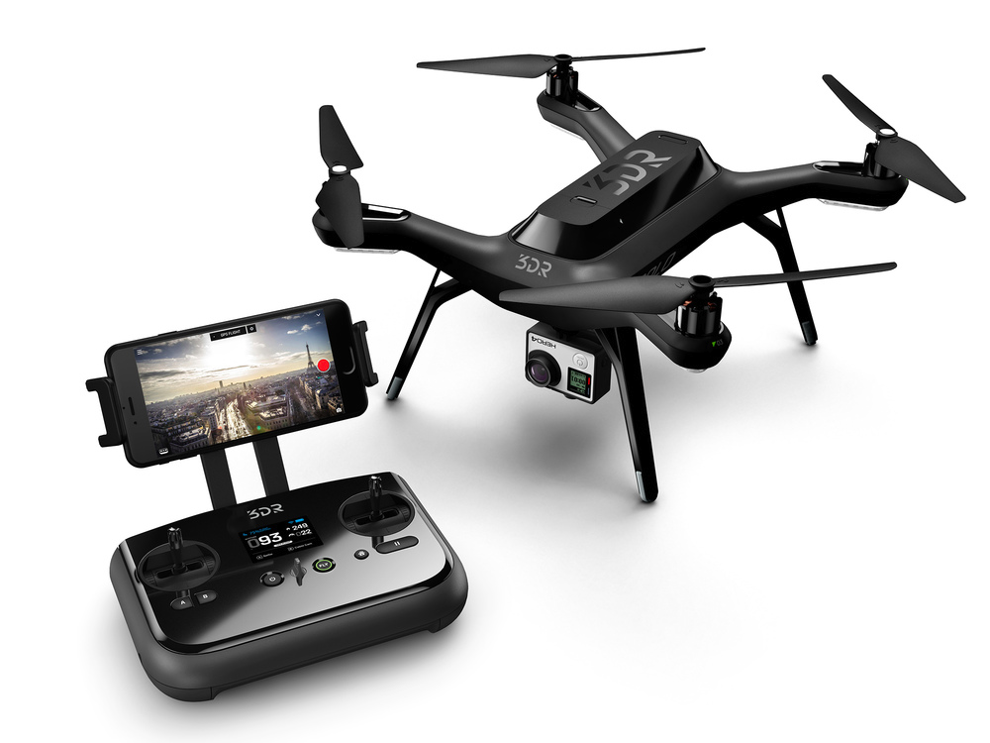
Debate Team
Take out 2 colors of highlighters (BORROW from box if necessary)
Today’s Agenda
Issue background: Read & categorize research (new GAFE doc) & developing claims
Notes:
2 sources from GT office

Slide 8
11/13 Welcome Debate!
Take one of each handout (3) & start working on the argument worksheet.
Today:
Argument Structure
Evidence Cards
Continue Research
Next class: 2 evidence cards due & choose a side
Notes:
As research & learn about topic, looking for arguments on both sides and evidence to back them up. After we find several, we’ll identify the top 3 on each side.
Argument structure
Highlight parts of evidence cards HO: set up notes like this, either on paper, notecards, or in GAFE (will print and cit later)
Did we go over debate components? Maybe just save for next class (along w/video)
Next class: be ready to choose side based on initial research. Everyone should have created at least two evidence cards.
Argument structure (ARE) 2.3 – project
(Skip 2.1 and 2.2)
PRINT LPs – 2.3, 2.7 (evidence cards) & copy EC for handout & Beware
- char evidence (evidence strip lesson…save for later though, if at all)
handouts
Debate components sheet
ARE practice (TR 1)
Types of evidence
Evidence cards

Slide 9
12/9 Welcome Debate!
Take one of each handout (2) & login to a laptop
Read & highlight the handouts
Today:
Argument Structure
Evidence Cards
Continue research & choose role/side
HW – survey after Monday 12/14

Slide 10
12/22 Welcome 8th Grade Debate!
Login to laptop – go to: GAFE and
http://patapscogt.weebly.com
Today:
Choose mock debate role/side
Review evidence cards
Organize/prioritize arguments

